Slide 1
Webinar “Uniting efforts to support the Leber Hereditary Optic Neuropathy (LHON) patient and family community” an activity in collaboration between European Blind Union (EBU) and Santhera Pharmaceuticals
24 January 2019, 10.00-11.30 CET

Slide 2
Agenda
Introduction to webinar and its speakers, by Dr Vanessa FERREIRA, PhD, MBA (Head of Patient Advocacy Europe at Santhera) and Mr Mokrane BOUSSAID (EBU Executive Director) (5 minutes)
Key learnings from two European Patient Advocacy Groups Advisory Board meetings for LHON, by Vanessa FERREIRA (15 minutes)
LHON clinical development and management, by Dr Xavier LLÒRIA, MD, LHON Medical Affairs Manager EU & ROW at Santhera (15 minutes)
LHON testimonials (10 minutes/each)
  By Dr Ana VELOSA (LHON patient advocate Portugal, mother to a LHON patient)
  By Gertrudis ABAD (ASANOL patient representative, mother to a LHON patient)
Helping EBU members identify and assist LHON patients, moderated by Vanessa FERREIRA (10 minutes)
  By Ana VELOSA (LHON patient advocate Portugal, mother to LHON patient)
  By Gertrudis ABAD (ASANOL patient representative, mother to a LHON patient)
Q&A (20 minutes) (all together)
Closing remarks (5 minutes) (all together)

Slide 3
Goals
To increase visibility of rare diseases, and specifically for LHON
To extend and share knowledge about LHON challenges and to identify ways to address it
To connect stakeholders
To facilitate possible multi-stakeholder collaborations and actions

Slide 4
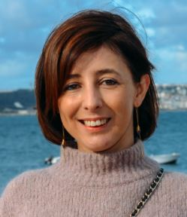
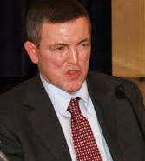

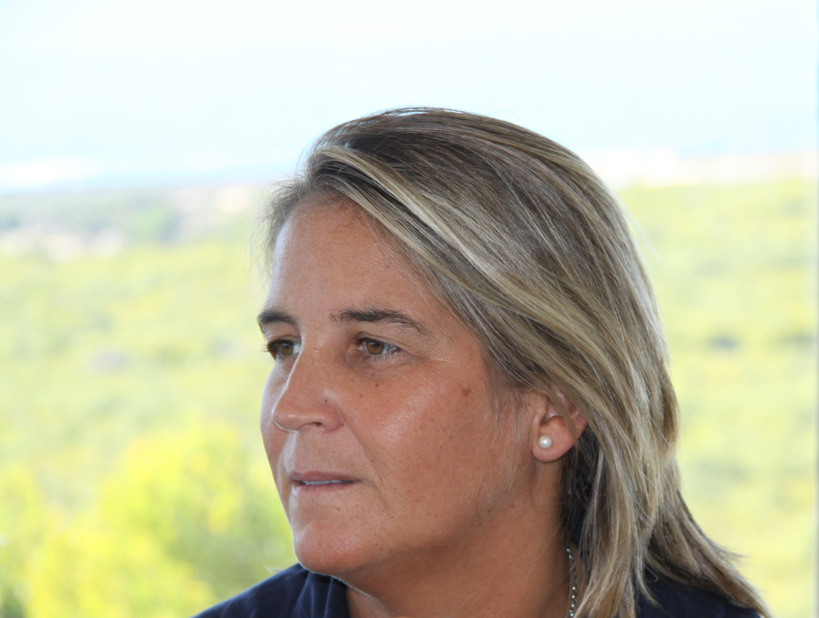
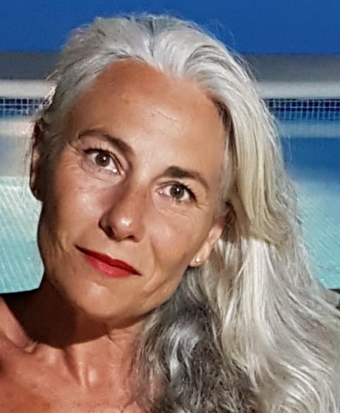
Speakers and moderators
Vanessa
FERREIRA
Santhera
Mokrane
BOUSSAID
EBU
Xavier
LLÒRIA
Santhera
Ana
VELOSA
LHON Portugal
Gertrudis
ABAD
LHON Spain

Slide 5
Agenda
Introduction to webinar and its speakers, by Dr Vanessa FERREIRA, PhD, MBA (Head of Patient Advocacy Europe at Santhera) and Mr Mokrane BOUSSAID (EBU Executive Director) (5 minutes)
Key learnings from two European Patient Advocacy Groups Advisory Board meetings for LHON, by Vanessa FERREIRA (15 minutes)
LHON clinical development and management, by Dr Xavier LLÒRIA, MD, LHON Medical Affairs Manager EU & ROW at Santhera (15 minutes)
LHON testimonials (10 minutes/each)
  By Dr Ana VELOSA (LHON patient advocate Portugal, mother to a LHON patient)
  By Gertrudis ABAD (ASANOL patient representative, mother to a LHON patient)
Helping EBU members identify and assist LHON patients, moderated by Vanessa FERREIRA (10 minutes)
  By Ana VELOSA (LHON patient advocate Portugal, mother to LHON patient)
  By Gertrudis ABAD (ASANOL patient representative, mother to a LHON patient)
Q&A (20 minutes) (all together)
Closing remarks (5 minutes) (all together)

Slide 6

What is Leber’s Hereditary Optic Neuropathy (LHON) ?
LHON is a rare mitochondrial disease

Slide 7


Common Disease
Rare Disease (RD)

Slide 8

What are Rare Diseases (RDs)?
is a disease affecting less than 1 in 2,000 citizens

Slide 9

Rare Disease Facts and Figures
350-400 million
people worldwide
1 in 17 people suffers from a RD
30 million
people

Slide 10

What are Rare Diseases (RDs)?
In the UK, approximately 3.5 million people live with RDs
is a disease affecting less than 1 in 2,000 citizens

Slide 11



Key message 1
Rare Diseases as a Public Health Priority

Slide 12


Rare Disease Facts and Figures
7000
Rare Diseases exist
Less 5%
of Rare Diseases have treatments.
Approximately 50% of the people affected by rare diseases are children
80% of rare diseases
are genetic

Slide 13





Characteristics of Rare Diseases (RDs)

Slide 14
Characteristics of Rare Diseases (RDs)
Cystic Fibrosis (CF)
Duchenne Muscular Dystrophy (DMD)
Haemophilia
Phenylketonuria (PKU)
Primary ciliary dyskinesia
Darier disease
Smith-Lemli-Opitz syndrome
Usher syndrome
Retinitis Pigmentosa
Behçet’s Disease
Stargardt Disease
Usher Syndrome
Idiopathic Intracranial Hypertension
Leber Hereditary Optic Neuropathy (LHON)
Bietti’s Crystalline Dystrophy
Uveal Coloboma

Slide 15









Key message 2
Tackling Rare Diseases requires innovative thinking and collaborative approach.

Slide 16
What is Leber’s Hereditary Optic Neuropathy (LHON) ?
LHON is a rare mitochondrial disease

Slide 17
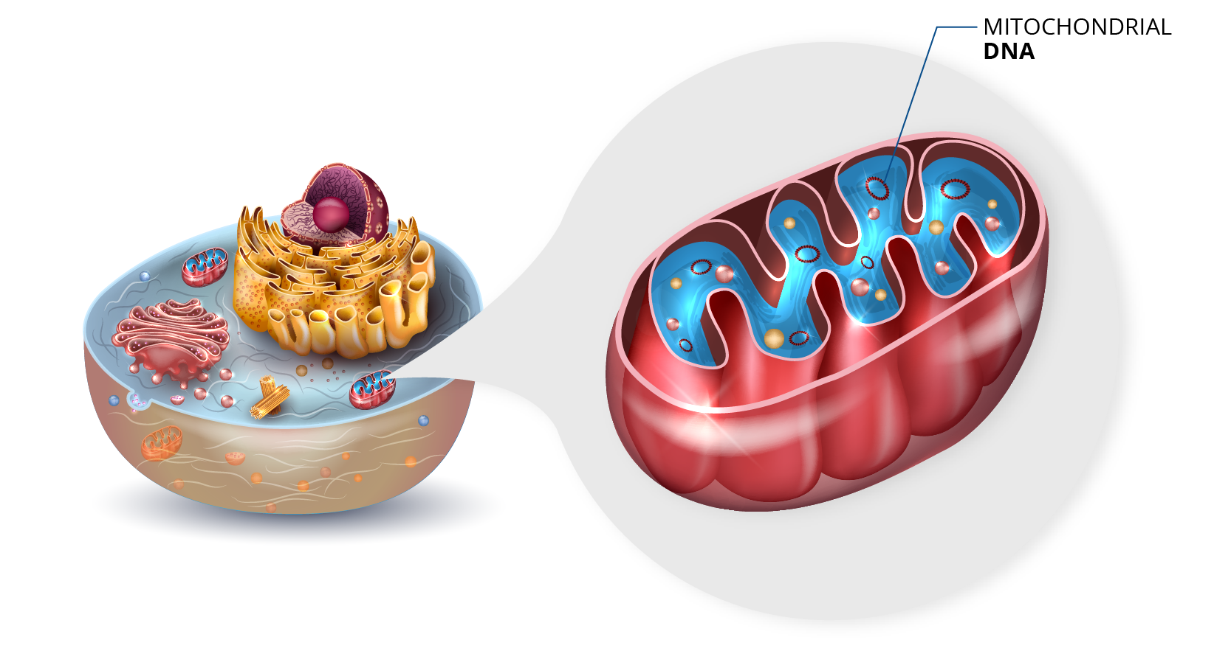
Mitochondrial disease

Slide 18
Are there associations for Leber’s Hereditary Optic Neuropathy (LHON) ?

Slide 19
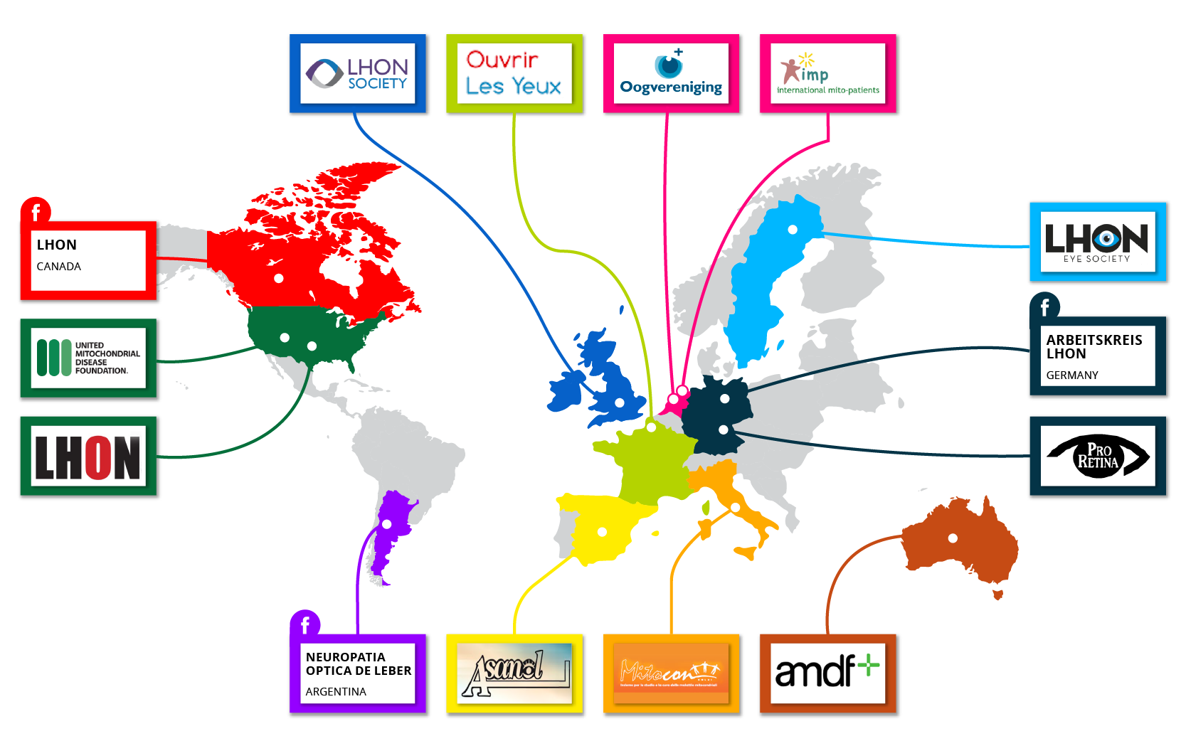
The LHON and related patient groups
= Facebook group

Slide 20
Which activity could help at pan-European manner LHON
?
Identifying patients’ priorities and experiences
Empowering (Information exchange)
Breaking isolation & Connect (Network and Work together)
Raising awareness

Slide 21



Method European LHON Patient Groups Advisory Board
Mixed research approach
Participants
Sweden
Germany
United Kingdom
France
Italy
Spain
Portugal
Romania
Survey
Face to face
Webinar

Slide 22
RESULTS SURVEY

Slide 23
LHON patients path to diagnosis and its immediate impact
Opticians or optometrists are usually the health care professionals providing the first consultation
At least 5 health care professionals are visited before getting a final diagnosis
Over 6 months between first symptoms and final diagnosis
Patients receive 3 main different diagnosis before the final diagnosis is issued
Immediate impact of LHON on patients’ family experience
  Isolation

Slide 24
Key message 3
Getting a timely and accurate diagnosis is a challenge for patients and families living with LHON
LHON families face unique obstacles (diagnosis itself is isolating)
Face-to-face meeting
AWARENESS
EDUCATION
ISOLATION

Slide 25
Priorities for action
Advocacy
Awareness
Lobby
LHON European Federation
Collaboration
Exchange information
Patient Engagement (PE)
Community
16
Care
European Reference Network
Access to psychosocial services
Education
Conferences
Research
European patient registry
Support research
More collaboration

Slide 26
European LHON Map of activities considered best practices
Scientific and medical Conferences
Collaboration with umbrella/related disease organisations
22
Educational
Work life
Tailored family meetings
Health Technology
Assessment
Multilevel patient support
Social media presence

Slide 27
Key message 4
Mixed method research has high potential for rare diseases like LHON
  Capture the whole picture
  Empowering (Information exchange)
  Break isolation & Connect (Networking and Working together)
  Raising awareness

Slide 28
Speakers and moderators
Vanessa
FERREIRA
Santhera
Mokrane
BOUSSAID
EBU
Xavier
LLÒRIA
Santhera
Ana
VELOSA
LHON Portugal
Gertrudis
ABAD
LHON Spain

Slide 29
Agenda
Introduction to webinar and its speakers, by Dr Vanessa FERREIRA, PhD, MBA (Head of Patient Advocacy Europe at Santhera) and Mr Mokrane BOUSSAID (EBU Executive Director) (5 minutes)
Key learnings from two European Patient Advocacy Groups Advisory Board meetings for LHON, by Vanessa FERREIRA (15 minutes)
LHON clinical development and management, by Dr Xavier LLÒRIA, MD, LHON Medical Affairs Manager EU & ROW at Santhera (15 minutes)
LHON testimonials (10 minutes/each)
  By Dr Ana VELOSA (LHON patient advocate Portugal, mother to a LHON patient)
  By Gertrudis ABAD (ASANOL patient representative, mother to a LHON patient)
Helping EBU members identify and assist LHON patients, moderated by Vanessa FERREIRA (10 minutes)
  By Ana VELOSA (LHON patient advocate Portugal, mother to LHON patient)
  By Gertrudis ABAD (ASANOL patient representative, mother to a LHON patient)
Q&A (20 minutes) (all together)
Closing remarks (5 minutes) (all together)

Slide 30
LHON: Clinical and management overview
Dr. Xavier Llòria, MD
Medical Affairs Manager LHON
Santhera Pharmaceuticals

Slide 31
Table of contents
  What is a mitochondrial disease? What is LHON?
  What causes LHON?
  Epidemiology (frequency in and distribution as for sex, and age when clinical symptoms manifest?)
  When to suspect LHON? how is diagnostic done?
  Clinical Management and Therapeutic approach. Are there guidelines for care and management?
  Increasing awareness amongst Health Professionals

Slide 32
LHON is a type of mitochondrial disease
  LHON (Leber’s Hereditary optic neuropathy) is a mitochondrial disease
  Mitochondria are the “power stations” of our cells. They produce the energy that cells need to function normally.
  When a disease affects one or more of the components of mitochondria, we call it mitochondrial disease.

Slide 33
LHON is a type of mitochondrial optic neuropathy which causes blindness
  It is caused by a genetic defect in one specific component which is key for the correct function of the mitochondria.
  LHON characteristically affects the nerve that transmits the visual information from the eye to the brain. So, it is an OPTIC NEUROPATHY.
  It is a MITOCHONDRIAL OPTIC NEUROPATHY

Slide 34
LHON is a genetic disease
  In LHON, the cause for this defect is a mutation in specific parts of the DNA of the mitochondria.
  This affects the capability of the mitochondria to generate energy.
  If the cells in the optic nerve don’t have enough energy, they cannot transmit the impulses from the eye, resulting in a form of BLINDNESS.

Slide 35
How is LHON transmitted?
Because it is a MITOCHONDRIAL GENETIC disease the transmission can only be from MOTHERS to sons and daughters (fathers don’t transmit the disease),so:
A mother with the genetic mutation will transmit the mutation to all her children, regardless of her being symptomatic or not.

Slide 36
How is LHON transmitted? (cont.)
A father with the genetic mutation will NOT transmit the mutation to any of his children, regardless of him being symptomatic or not.

Slide 37
Epidemiology: How rare is LHON?
  It is not exactly known how many people suffer from LHON.
  It is estimated that in EU there are between 11000 and – 19000 people living with LHON.
  Because it is an infrequent disease that can be confused with other forms of blindness, there are probably many patients still to be diagnosed.

Slide 38
Age and gender in LHON
  LHON can affect both males and females of any age. HOWEVER:
  Males develop the disease more often than females
  Symptoms usually start between 15 and 35 years of age.

Slide 39
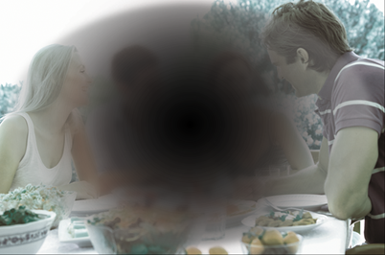
When to suspect LHON: Clinical manifestations
Central vision loss
Painless
Progressive over days or months
Young adult
First affects one eye and then the other after a few weeks

Slide 40
Always consider family history or relatives with some form of “blindness”
An important clue in suspecting LHON is the existence of familial history of LHON or similar “blindness” in the mother side of the family.

Slide 41
Diagnosis
The family history, clinical manifestations, visual examination and tests will strongly suggest that it is LHON in many cases.
Confirmation is done by identifying the causing mutations through a genetic test of the mitochondrial DNA. This test is available in many centres worldwide.

Slide 42
What other diseases can produce similar clinical manifestations?
The specialist will rule out other diseases that produce central vision loss. The clinical picture, form of onset, family history and evolution will help in the diagnosis.
Optic neuritis is more frequent than LHON and it is usually confused with it
Dominant optic atrophy
Compressive optic neuropathy
Infiltrative or inflammatory optic neuropathy
Ischemic optic neuropathy
Toxic or nutritional optic neuropathy
Optic nerve hypoplasia

Slide 43
Prognosis
In the absence of treatment LHON usually results in irreversible, bilateral, severe blindness, within one year since onset.
Some patients may present less severe blindness and/or some partial improvement of the visual function.

Slide 44
Management and therapy
The first International Consensus Statement on the Clinical and Therapeutic Management of Leber Hereditary Optic Neuropathy was published in 2017 by a group of international LHON experts.

Slide 45
It concerns the family
When a member of a family is diagnosed with LHON, his/her siblings, their mother and their mother’s siblings must be aware they are at risk as well.
Some lifestyle changes are important to try to avoid developing or worsening the disease
It is very important to avoid some toxics: tobacco, alcohol, certain medicines.

Slide 46
Therapy
There is no preventive treatment available.
In the EU there is a treatment approved that may help ameliorate the blindness.
There are clinical studies ongoing with different treatments.
Your LHON specialist will inform you about the treatment and clinical studies available.

Slide 47
Why is awareness important?
  Diagnose in early phases of the disease
  Better option to receive available treatment or participate in clinical trials
  Avoid unnecessary delays and tests in diagnostic procedure
  Adopt preventive measures and adapt lifestyle of patients and relatives at risk.

Slide 48
How to increase awareness?
  Health professionals
  Patients and relatives
  Health Authorities

Slide 49
Increasing awareness amongst Health Professionals?
  Continuous Medical Education
    Scientific Societies (National and International Congresses)
    Journals and publications
    Experts training non-experts
  Monographic meetings
  Therapy information by pharmaceutical representatives
  Clinical studies
  Registries
  Patients educating non-specialists
  Patient group-specialists meetings

Slide 50
Conclusions
LHON is a rare form of inherited, irreversible, severe, blindness which affects mainly young adults and is probably underdiagnosed because of lack of awareness.
Although there is no cure yet, specific treatment is available and new therapies are being investigated.
Increase awareness will facilitate early diagnosis and increase the opportunity of therapeutic options or participation in clinical trials.

Slide 51
Agenda
Introduction to webinar and its speakers, by Dr Vanessa FERREIRA, PhD, MBA (Head of Patient Advocacy Europe at Santhera) and Mr Mokrane BOUSSAID (EBU Executive Director) (5 minutes)
Key learnings from two European Patient Advocacy Groups Advisory Board meetings for LHON, by Vanessa FERREIRA (15 minutes)
LHON clinical development and management, by Dr Xavier LLÒRIA, MD, LHON Medical Affairs Manager EU & ROW at Santhera (15 minutes)
LHON testimonials (10 minutes/each)
  By Dr Ana VELOSA (LHON patient advocate Portugal, mother to a LHON patient)
  By Gertrudis ABAD (ASANOL patient representative, mother to a LHON patient)
Helping EBU members identify and assist LHON patients, moderated by Vanessa FERREIRA (10 minutes)
  By Ana VELOSA (LHON patient advocate Portugal, mother to LHON patient)
  By Gertrudis ABAD (ASANOL patient representative, mother to a LHON patient)
Q&A (20 minutes) (all together)
Closing remarks (5 minutes) (all together)

Slide 52
Speakers and moderators
Vanessa
FERREIRA
Santhera
Mokrane
BOUSSAID
EBU
Xavier
LLÒRIA
Santhera
Ana
VELOSA
LHON Portugal
Gertrudis
ABAD
LHON Spain

Slide 53
Topics that will be addressed
From the first symptoms to definitive diagnosis
Coping with LHON diagnosis
Advices for other patients and families
Challenges in dealing with LHON in Portugal and possible solutions

Slide 54
Speakers and moderators
Vanessa
FERREIRA
Santhera
Mokrane
BOUSSAID
EBU
Xavier
LLÒRIA
Santhera
Ana
VELOSA
LHON Portugal
Gertrudis
ABAD
LHON Spain

Slide 55
Topics that will be addressed
From the first symptoms to definitive diagnosis
Coping with LHON diagnosis
Advices for other patients and families

Slide 56






Awareness activity through testimonials
2018
2019
Russell Wheeler
(LHON UK)
Ana Velosa
(LHON Portugal)
Krister Inde
(LHON Eye Society,
Sweden)
Fabrizio Sottile
(MITOCON, Italy)
Pedro Recover
(ASANOL, Spain)
Fredrick Lindemark
(LHON Sweden)
Maryse Roger
(Ouvrir Les Yeux,
France)
Paula Treu
(MITOCON, Italy)
Francesca Muller
(LHON Germany)
Christiane Frankner
(LHON Germany)
Combined
article

Slide 57
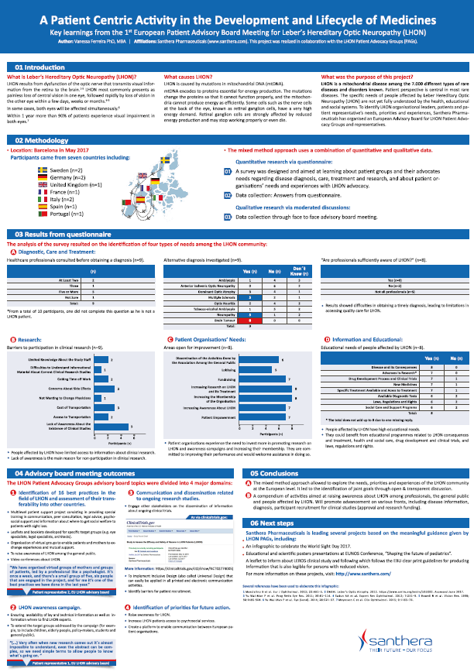
Awareness through conferences
2nd annual Patients as Partners EU
  23-24 January 2018, London, UK
DIA Europe 2018
  18 April 2018, Basel, Switzerland
MITOCON conference for poster presentation
  25 May 2018 Rome, Italy
Ouvrir Les Yeux (LHON France)
  26 May 2018 Paris, France
Oogverening (Eye Association for Netherlands)
  22 September 2018, Rotterdam, The Netherlands

Slide 58

Awareness through conferences
European Blind Union (EBU)
  24 January 2019, Webinar
3rd annual Patients as Partners EU
  28-29 January 2019, London, UK
ASANOL National conference
  26-27 April 2019, Madrid, Spain
LHON Eye Society (Sweden)
  7-8 June 2019, Södertälje, Sweden

Slide 59

Awareness through collaboration with umbrella/related disease organisations
Newsletter
  Finding the roadmap for living with LHON
  In four languages: EN, FR, IT, SP,GR
Website
  http://www.euroblind.org/
Webinar
  Emailing
  Record will be available HERE

Slide 60
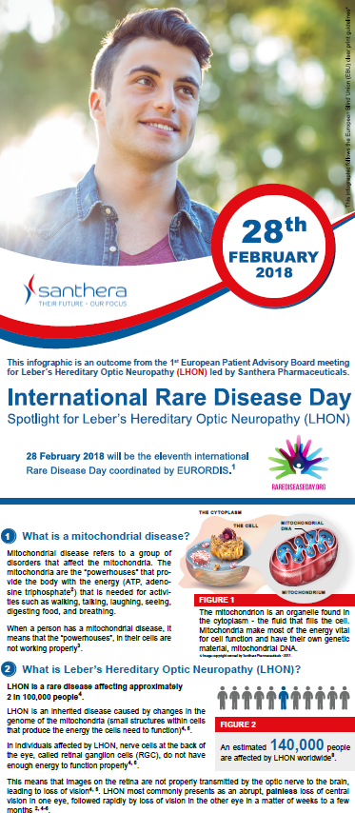
Awareness through educational materials
Infographic explaining
  What is LHON, its signs and symptoms
  Available HERE
Dissemination achieved during Rare Disease Month
  1600 Page views
  1300 Unique visitors and
  A sustained average time on page for the content of over 1.5 minutes

Slide 61
Agenda
Introduction to webinar and its speakers, by Dr Vanessa FERREIRA, PhD, MBA (Head of Patient Advocacy Europe at Santhera) and Mr Mokrane BOUSSAID (EBU Executive Director) (5 minutes)
Key learnings from two European Patient Advocacy Groups Advisory Board meetings for LHON, by Vanessa FERREIRA (15 minutes)
LHON clinical development and management, by Dr Xavier LLÒRIA, MD, LHON Medical Affairs Manager EU & ROW at Santhera (15 minutes)
LHON testimonials (10 minutes/each)
  By Dr Ana VELOSA (LHON patient advocate Portugal, mother to a LHON patient)
  By Gertrudis ABAD (ASANOL patient representative, mother to a LHON patient)
Helping EBU members identify and assist LHON patients, moderated by Vanessa FERREIRA (10 minutes)
  By Ana VELOSA (LHON patient advocate Portugal, mother to LHON patient)
  By Gertrudis ABAD (ASANOL patient representative, mother to a LHON patient)
Q&A (20 minutes) (all together)
Closing remarks (5 minutes) (all together)

Slide 62
Helping EBU members identify and assist LHON patients
EBU
European current projects
Campaigning, Capacity- building, Information and Communication
41 EBU National Members
Country specific current projects
Campaigning, Capacity- building, Information and Communication
Rare Eye Diseases

Slide 63

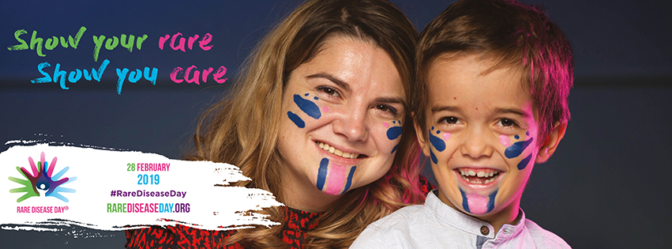
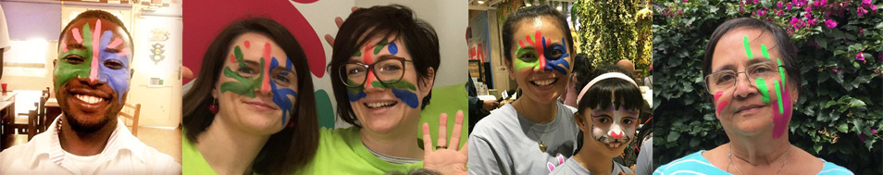
Rare Disease Day 2019:
Bridging health and social care
Poster
Social media banners and profile picture
Email signature
#ShowYourRare for Rare Disease Day!

Slide 64


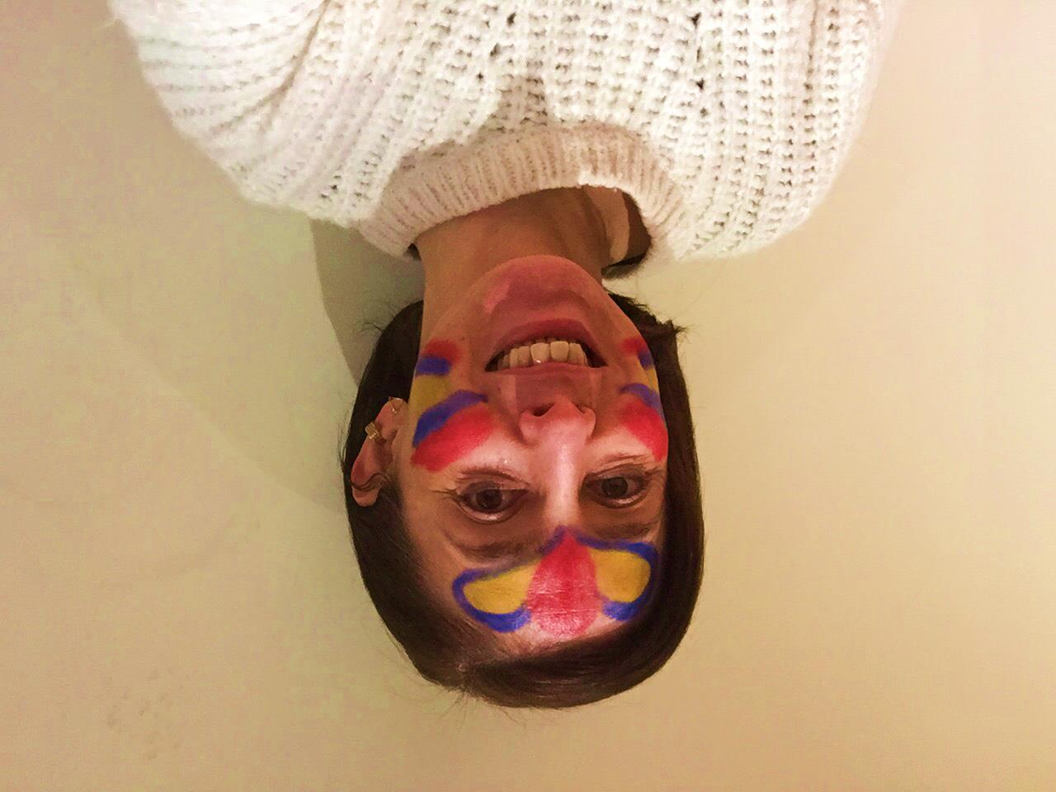
THANK YOU
vanessa.dosreisferreira@santhera.com

